Slide 1
Intermediate Code Generation - I

Slide 2
Compiler Architecture
Intermediate Code
Parser
Static
Checker
Intermediate
Code generator
Code
Generator
Target
language
Front End
Back End
We assume parsing, static checking and intermediate code generation is done sequentially
  These can be combined and done during parsing
Static Checking
  Operator operand compatibility (type checking)
  Proper placement of break/continue keywords etc. (flow-of-control checking)
  An object must be defined exactly once (uniqueness checking)
  Same name must appear at most once (name-related checking)

Slide 3
Intermediate Code
Intermediate codes are machine independent codes, but they are close to machine instructions.
The given program in a source language is converted to an equivalent program in an intermediate language by the Intermediate Code generator.
Ties the front and back ends together
Advantages:
A compiler for a different machine can be created by attaching
a back-end for the new machine to an existing front end.
A machine-independent code optimizer can be applied to the
intermediate representation

Slide 4
Intermediate Code (Cont..)
In the process of translating a program in a given source language into code for a given target machine, a compiler may construct a sequence of intermediate representations.
High Level
Intermediate
Representation
Low Level
Intermediate
Representation
Source
Program
Target
Code
Close to source language
Close to machine code

Slide 5
Intermediate Code (Cont..)
Intermediate language can be many different languages, and the designer of the compiler decides this intermediate language.
  syntax trees can be used as an intermediate language.
  postfix notation can be used as an intermediate language.
  three-address code can be used as an intermediate language
Intermediate language may have various levels.

Slide 6
Intermediate Languages Types
Graphical Intermediate Representations:
  Abstract Syntax trees
  Directed Acyclic Graphs
  Control Flow Graphs
Linear Intermediate Representations :
  Stack based (postfix)
  Three address code (quadruples)

Slide 7
Graphical Intermediate Representations
Abstract Syntax Trees (AST) – retain essential structure of the parse tree, eliminating unneeded nodes.
Directed Acyclic Graphs (DAG) – compacted AST to avoid duplication – smaller footprint as well
Control flow graphs (CFG) – explicitly model control flow

Slide 8
Abstract Syntax Trees and Directed Acyclic Graphs
a := b *-c + b*-c
:=
:=
a
+
a
+
*
*
*
b
- (uni)
b
- (uni)
b
- (uni)
c
c
c
AST
DAG

Slide 9
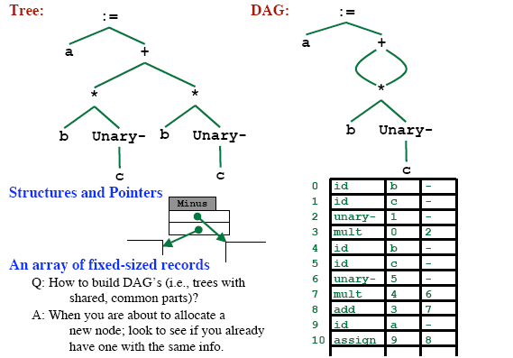
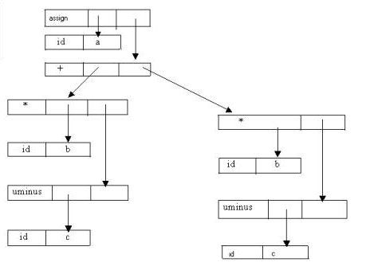
Implementation of DAG/AST: Value Number Method

Slide 10
Three-Address Code
A three-address code is:
x := y op z
where x, y and z are names, constants or compiler-generated temporaries; op is any operator.
But we may also use the following notation for three-address code (it looks like a machine code instruction)
op y,z,x
apply operator op to y and z, and store the result in x.
We use the term “three-address code” because each statement usually contains three addresses (two for operands, one for the result).

Slide 11
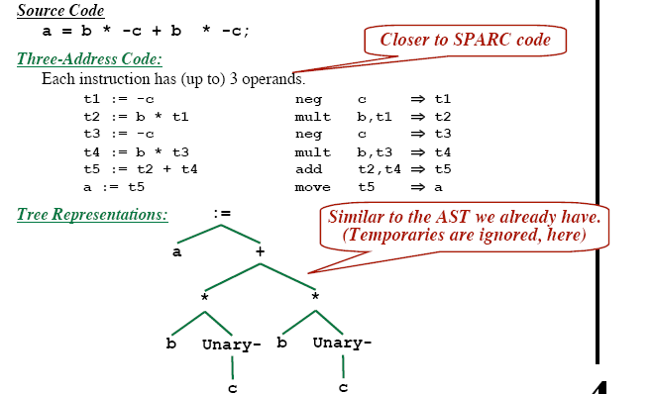
Linearized Representation of AST
Source Code
  a := b * -c + b * -c
Three address code
Tree Representation

Slide 12
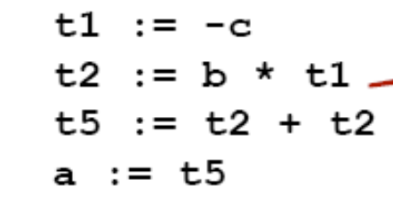
Linearized Representation of DAG
Source Code
  a := b * -c + b * -c
Three address code
DAG Representation

Slide 13
Three-Address Statements
Similar to assembly code.
Assignment Type 1: x := y op z
op is a binary arithmetic or logical operation
x, y and z are addresses
Assignment Type 2: x := op z
op is a unary arithmetic or logical operation
x and z are addresses
Copy Instruction: x := y
x and y are addresses and x is assigned the value of y

Slide 14
Three-Address Statements (Cont..)
Unconditional Jump: goto L
We will jump to the three-address code with the label L, and the execution continues from that statement.
Ex: goto L1 // jump to L1
Conditional Jump: if x relop y goto L
We will jump to the three-address code with the label L if the result of x relop y is true, and the execution continues from that statement. If the result is false, the execution continues from the statement following this conditional jump statement.

Slide 15
Three-Address Statements (Cont..)
Procedure Parameters: param x
Procedure Calls: call p,n
Return: return y
where x is an actual parameter, we invoke the procedure p with n
parameters.
Ex: param x₁
param x₂
…… ➔ p(x₁,...,x_{n})
param x_{n}
call p,n

Slide 16
Three-Address Statements (Cont.)
Indexed Assignments:
- x := y[i]
sets x to the value in location i memory units beyond location y
- x[i]:= y
sets contents of the location i memory units beyond location y to
the value of x.
Address and Pointer Assignments:
- x := &y sets the value of x to be the location of y
- x := *y where y is a pointer whose r-value is a location sets the
r-value of x equal to the contents of that location
-*x := y sets the r-value of the object pointed by x to the r-value
of y

Slide 17
Three Address Code Example
do i=i+1; while (a[i*8] < v);
L: t₁=i+1 100: t₁ = i+1
i=t₁ 101: i = t₁
t₂=i*8 102: t₂=i*8
t₃=a[t₂] 103: t₃=a[t2]
if t₃ < v goto L 104: if t₃ < v goto 100
(A) Symbolic Labels (B) Position Numbers

Slide 18
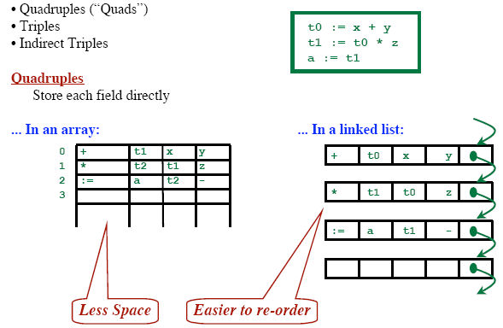
Representing 3-Address Statements
x := minus y
  Does not use arg2
x := y
  Op is :=
param a1
  Uses neither arg2 nor result
Conditional/Unconditional jumps
  Put the target label in result
op, arg1, arg2, result

Slide 19
Quadruples
A quadruple is a record structure with four fields: op, arg1, arg2, result.
a = b * -c + b * -c
 | op | arg1 | arg2 | result
(0) | uminus | c |  | t₁
(1) | * | b | t₁ | t₂
(2) | uminus | c |  | t₃
(3) | * | b | t₃ | t₄
(4) | + | t₂ | t₄ | t₅
(5) | := | t₅ |  | a

Slide 20
Quadruples (Cont..)
Store each fields directly

Slide 21
Triples
Avoids entering temporary names into the symbol table.
Temporary values are referred by the position of the statement that computes it.
Requires three fields: op, arg1, arg2.
a = b * -c + b * -c
 | op | arg1 | arg2
(0) | uminus | c
(1) | * | b | (0)
(2) | uminus | c
(3) | * | b | (2)
(4) | + | (1) | (3)
(5) | assign | a | (4)

Slide 22
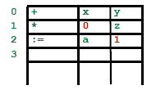
Triples
Saves storage.
Difficult to reorganize instructions.
A ternary operation like x[i] := y requires two entries in the triple structure.
 | op | arg1 | arg2
(0) | [ ] = | x | i
(1) | assign | (0) | y
 | op | arg1 | arg2
(0) | [ ] = | y | i
(1) | assign | x | (0)
x[i] := y x := y[i]

Slide 23
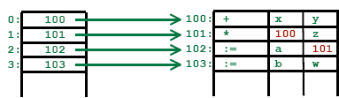
Indirect Triples
Listing pointer to triples.
Solves the reordering problem.
a = b * -c + b * -c
 | stmnt
(0) | (14)
(1) | (15)
(2) | (16)
(3) | (17)
(4) | (18)
(5) | (19)
 | op | arg1 | arg2
(14) | uminus | c
(15) | * | b | (14)
(16) | uminus | c
(17) | * | b | (16)
(18) | + | (15) | (17)
(19) | assign | a | (18)

